Slide 1
Pathways to Medicine
2022

Slide 2
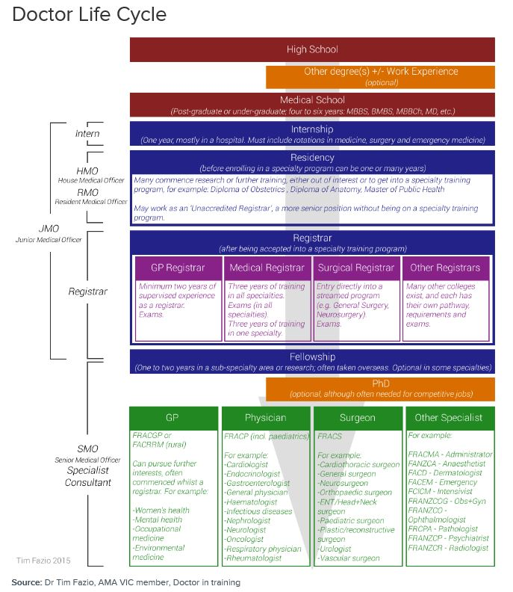
Doctor Life Cycle
Undergraduate or Graduate Medical Degree
Source: Australian Medical Association: https://ama.com.au/careers/becoming-a-doctor

Slide 3
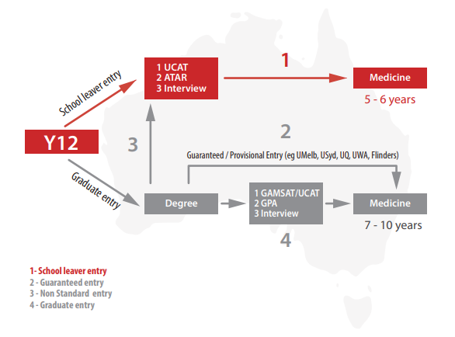
Pathways to Medicine
From the MedEntry UCAT Handbook 2021

Slide 4
Undergraduate Medicine Courses
Victoria
Monash University: Bachelor of Medical Science (requires UCAT)
New South Wales
University of NSW: Bachelor of Medical Studies/Doctor of Medicine (requires UCAT – interview late January)
University of Newcastle: Bachelor of Medical Science and Doctor of Medicine (Joint Medical Program) (requires UCAT – interview mid January)
University of Western Sydney: Doctor of Medicine (requires UCAT – interview in late November)
Queensland
Bond University: Bachelor of Medical Studies and Doctor of Medicine (does not require UCAT – interviews in February)
James Cook University: Bachelor of Medicine, Bachelor of Surgery (does not require UCAT – interviews in January)
South Australia
University of Adelaide: Bachelor of Medicine, Bachelor of Surgery (requires UCAT – interview in late November)
Tasmania
University of Tasmania: Bachelor of Medicine, Bachelor of Surgery (requires UCAT – no interview)
Western Australia
Curtin University: Bachelor of Medicine, Bachelor of Surgery (requires UCAT – interview in January)

Slide 5
Undergraduate Medicine – Number of Places
Monash University: 242 direct entry positions
University of NSW: 189 domestic positions
University of Newcastle: 170 positions
University of Western Sydney: 120 positions
Bond University: 120 positions
James Cook University: 150 positions
University of Tasmania: not available
Curtin University: 80 positions

Slide 6
Undergraduate Medicine Applications
Victoria: VTAC – Term 3 - Opening early August, closing later September
Monash application process
Monash Bonded Medicine
Monash Extended Rural Cohort Medicine
New South Wales: UAC – Opening early August, closing late September
UNSW application process
MAP – Opening early May closing late September
University of Newcastle application process
Submit Joint Medical Application – available mid-August, due late September
University of Western Sydney application process

Slide 7
Undergraduate Medicine Applications
Queensland – QTAC
Bond University application process – applications due in Jan
James Cook University application process – applications due in Sept
James Cook application form due end of September
South Australia – SATAC – opens early August, closes late September
University of Adelaide application process
Tasmania
University of Tasmania application process – application open early August, closes late September
Western Australia – TISC – opens early July, closes late September
Curtin University application process
Predicted ATAR form due start of November

Slide 8
Graduate Medicine Courses
Victoria
University of Melbourne: Doctor of Medicine – GAMSAT Required
Deakin University: Doctor of Medicine – GAMSAT Required
Monash University: Graduate Entry Medicine – GAMSAT Not Required
New South Wales
University of Sydney: Doctor of Medicine – GAMSAT Required
University of Wollongong: Doctor of Medicine – GAMSAT Required
Macquarie University: Doctor of Medicine – GAMSAT Required
University of Notre Dame: Doctor of Medicine – GAMSAT Required
Australian Capital Territory
Australian National University: Doctor of Medicine and Surgery – GAMSAT Required
Queensland
University of Queensland: Doctor of Medicine – GAMSAT Required (not required for provisional entry directly after high school)
Griffith University: Doctor of Medicine – GAMSAT Required
South Australia
Flinders University: Doctor of Medicine – GAMSAT Required
Western Australia
University of Western Australia: Doctor of Medicine – GAMSAT Required
University of Notre Dame: Doctor of Medicine – GAMSAT Required

Slide 9
Monash Graduate-Entry Medicine
75 places are available
50 places are reserved for Monash University Bachelor of Biomedical Science students
25 places are available to Monash University students who complete:
Bachelor of Biomedical Science
Bachelor of Pharmacy (Honours)
Bachelor of Physiotherapy (Honours)
Bachelor of Science (with specific units)
No GAMSAT required
Approximately 540 students are offered a place in the Bachelor of Biomedical Science – 14% can move into graduate medicine

Slide 10
University of Melbourne – Doctor of Medicine
Entry Requirements
Any Bachelor degree
GAMSAT
Interview
Approximately 1/3 University of Melbourne Bachelor of Biomedicine students gain entry into the Doctor of Medicine

Slide 11
Deakin – Doctor of Medicine
Any Bachelor degree (4% bonus to scores if you complete it at Deakin)
GAMSAT
Interview
130 Commonwealth-supported places (CSP) and 37 Bonded Medical Places (BMP)

Slide 12
UCAT
University Clinical Aptitude Test
Verbal reasoning
Decision-making
Quantitative reasoning
Abstract reasoning
Situational judgement
Complete practice tests as preparation – paid services not recommended
Registration: March - May
Exam Dates: July - August
Full-fee = $298 - Concessions = $198
Practice exam provided upon registration

Slide 13
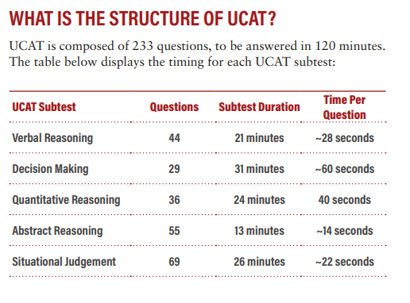
From the MedEntry UCAT Handbook 2021

Slide 14
Courses That Require UCAT
University of Adelaide: Medicine, Dental Surgery, Oral Health
Curtin University: Medicine
Monash University: Medicine
University of Newcastle/New England: Joint Medical Program
University of NSW: Medicine
University of Queensland: Medicine (provisional entry), Dental Science
University of Tasmania: Medicine
University of WA: Medicine (Direct Pathway), Dental Medicine (Direct Pathway)
Western Sydney University: Medicine
University of Auckland (NZ): Medicine
University of Otago (NZ): Medicine, Dental Surgery

Slide 15
UCAT Minimum Requirements
Monash – no UCAT requirements published
UNSW – 50th percentile
Newcastle – no UCAT requirements published
Western Sydney – no UCAT requirements published
Adelaide – no UCAT requirements published
Tasmania – 50th percentile
Curtin – no UCAT requirements published

Slide 16
Interview (MMI)
Skills
Motivation
Communication skills
Critical thinking
Ethical reasoning
Empathic reasoning
Teamwork and collaboration
Advocacy
Monash interview dates: early January
Source: Monash University: http://www.med.monash.edu.au/medicine/admissions/direct-entry/domestic.html#3

Slide 17
GAMSAT
Graduate Medical School Admissions Test
Reasoning in Humanities and Social Sciences
Written Communication
Reasoning in Biological and Physical Sciences
Required for entry into graduate medicine courses
Available to students in second last or last year of undergraduate degree
Monash University does not require GAMSAT for entry into it’s graduate-entry medicine program

