Slide 1
Special Entry Access Scheme SEAS

Slide 2
What is SEAS?
Special Entry Access Scheme
Adjustment for situations that disadvantage students
Entry into university courses with a lower ATAR score
Guaranteed entry into some universities
Provides scholarship opportunities
Application via VTAC (Victorian Tertiary Admissions Centre)

Slide 3
SEAS Categories
Category 1: Personal Information and Location
All students should apply for this category
Category 2: Disadvantaged Financial Background
Centrelink Statements or Family Tax Benefit notifications can be evidence
Category 3: Disability or Medical Condition
Requires Impact Statement and Statement of Support
Category 4: Difficult Circumstances
Requires Impact Statement and Statement of Support

Slide 4
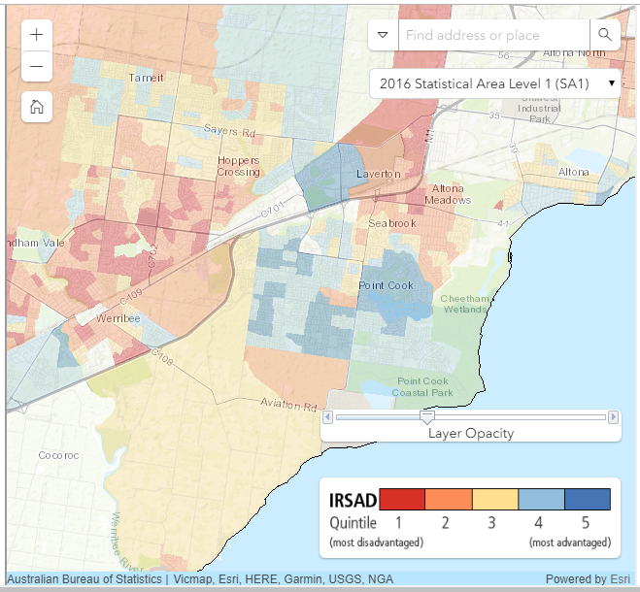
Category 1: Personal Information and Location
Timeline
Now - Visit Monash SEAS Calculator – Check your address?
Term 3 – Apply to VTAC
Documentation
Tick 2 boxes

Slide 5
SCHS Median Score
ATAR Boost

Slide 6
Category 2: Disadvantaged Financial Background
Timeline
Now – check with family – are you receiving Centrelink?
Term 3 – Apply to VTAC
Term 3 – collect supporting document
Documentation
Centrelink Statement – ask parents download from MyGov Account
Health Care Card

Slide 7
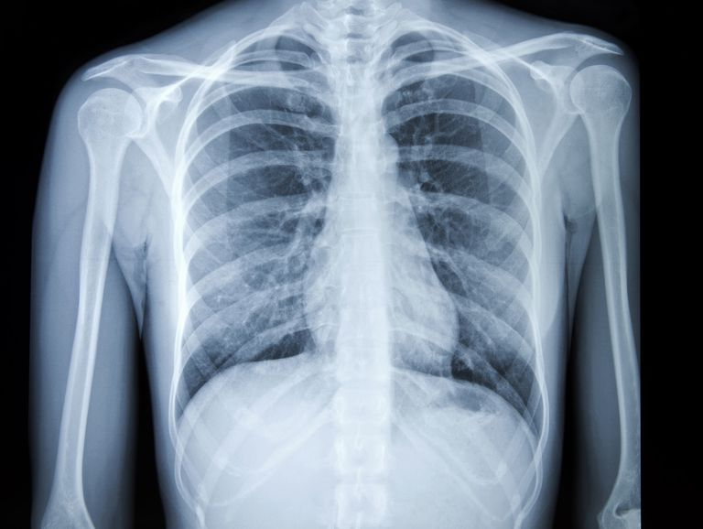
Category 3: Disability or Medical Condition
Timeline
Now – keep record of impact of condition
Term 3 – apply to VTAC and submit SEAS
Term 3 – book medical appointment to arrange supporting statement
Documentation
Personal Statement
Statement of Support
From a Doctor

Slide 8
Category 4: Difficult Circumstances
Timeline
Now – book an appointment with Wellbeing
Now – keep record of difficult circumstances
Term 3 – apply to VTAC and submit SEAS
Documentation
Personal Statement
Statement of Support
From wellbeing, or somebody who knows the situation

Slide 9
Impact Statements
Written by the student
500 characters outlining the circumstances
1500 characters outlining the impact on education
Keep a record of any disadvantage (such as absences from school during ongoing illness) – situation, date, impact on study (such as missing SAC)

Slide 10
Statements of Support
Written by a professional (eg. doctor, wellbeing staff, careers counsellor) who is aware of your situation
Over 21 years old
Not related or living with you
Known the applicant for 12 months or full duration of the circumstances
500 characters outlining the circumstances
1500 characters outlining the impact on education

Slide 11
Seeking Support from SCHS Staff
Requests for Statements of Support from school staff must be received by the second last week of Term 3
Students with ongoing disadvantage must discuss with careers/wellbeing staff in Term 2, and all follow-up appointments
Students who face new disadvantage during Year 12, should meet with careers/wellbeing staff as soon as possible
Provide your Impact Statement (if prepared)

Slide 12
Seeking Support from External Professionals
Discuss SEAS early (eg. if you attend an appointment at the start of the year, mention SEAS)
Provide the “Providing a Statement of Support” Guide
Provide your Impact Statement (if prepared)

Slide 13
University Entry Schemes
ACU: Entry Schemes
Deakin: SEAS and SEAS Calculator
La Trobe: VTAC Entry Access Schemes and ATAR Wizard
Monash: Monash Guarantee and SEAS and SEAS Calculator
RMIT: Equity Access Schemes
Swinburne: Special Consideration and SEAS Calculator
University of Melbourne: Access Melbourne
Victoria University: Special Admission Programs

Slide 14
Example of ATAR Guarantees Monash Guarantee
4 point drop in ATAR requirement

Slide 15
Example of SEAS Scholarships Access Melbourne Scholarship

Slide 16
Other Scholarships
Western Chances Scholarship
Financial Disadvantage
Apply mid-year
Wyndham Community Pathways Scholarship
Live in Wyndham
Financial Disadvantage
Apply mid-year
University Scholarships
Check University Scholarship Websites

Slide 17
Other Special Entry Programs
ACU: Community Achievers Program – Closes 14 August
La Trobe: Aspire Early Admissions Program – Opens mid-year
Victoria University: VU Guaranteed – Opens 15 July
ANU (Canberra): ANU Direct Application – Closes 31 May
Elite Athlete Program

Slide 18
Subject Bonus Points
Subject bonus points add to your aggregate, not your ATAR
Aggregate-ATAR conversation table (a non-linear relationship)
Bonuses listed in VTAC Coursesearch under Other Selection Considerations for each course

Slide 19
FAQ
I travel 2 hours each day to go to SCHS. Do I qualify for SEAS?
No. SEAS is for circumstances outside of your control.
Can I apply for multiple SEAS categories?
Yes. They can result in a lower ATAR requirement.
My Year 11 was impacted by disadvantage. Can I apply for SEAS?
Yes.

Slide 20
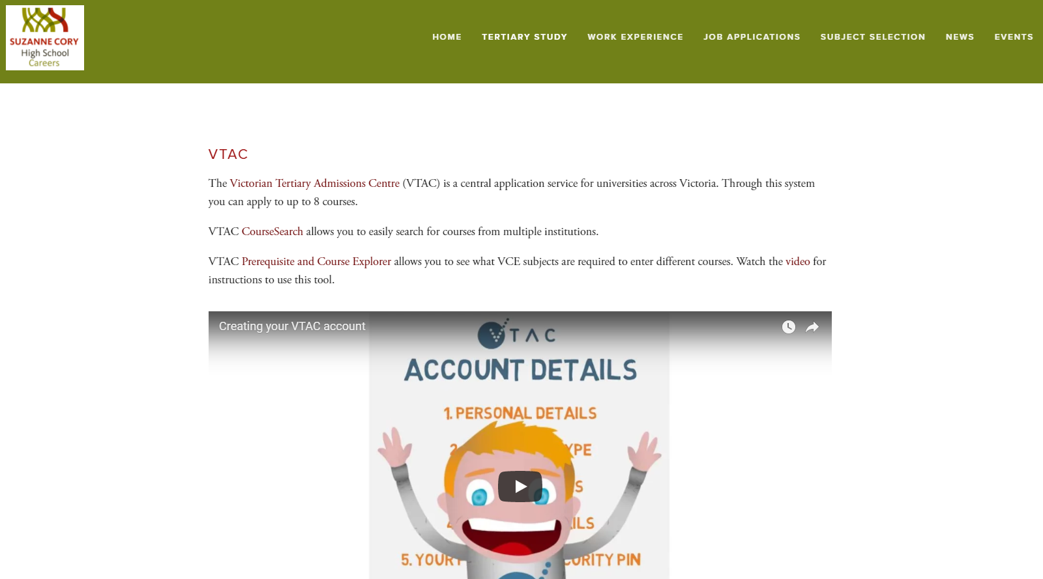
Support – SCHS Careers Website

Slide 21
Support – Book an Appointment
Book Via Compass star tab
All Year 12s will have an appointment with Careers by early Term 2

